Slide 1

Digital Portfolio
STUDENT NAME:P. Sathya Priyan
REGISTER NO AND NMID: 212400973/F7AED77877DE296A6CC4A9A5DD882B6
DEPARTMENT: BCA
COLLEGE: PRINCE SHRI VENKATESWARA ART’S AND SCIENCE COLLEGE/ MADRASUNIVERSITY
1

Slide 2

Portfolio of your
Sathya priyan P
2

Slide 3



AGENDA
Problem Statement
Project Overview
End Users
Tools and Technologies
Portfolio design and Layout
Features and Functionality
Results and Screenshots
Conclusion
Github Link
3/21/2024 Annual Review
3

Slide 4

PROBLEM STATEMENT
This portfolio website is designed to:Present my skills, experience, and projects in an organized way.
Provide a single platform where my work can be accessed anytime, anywhere.
Demonstrate my web development/design abilities through the portfolio itself.
For students → Focus on learning, showcasing academic projects.
For professionals → Emphasize career growth, job opportunities.
For freelancers → Stress on attracting clients and collaborations.
4

Slide 5

PROJECT OVERVIEW
About Me – A summary of my background and interests.
Skills – A list of technical and soft skills I possess.
– Highlights of my academic and personal projects.
Resume – Easy access to my CV for recruiters.
Section – To connect with potential employers, collaborators, and peers.
5

Slide 6

WHO ARE THE END USERS?
Recruiters & Hiring Managers – To evaluate your skills, projects, and suitability for a job.
2. Clients (for freelancers) – To check your past work and decide whether to hire you.
3. Teachers / Evaluators – If it’s an academic project, they review it for grading.
4. Peers & Collaborators – Students, colleagues, or developers who may want to collaborate.
5. General Audience – Anyone interested in knowing more about your work, achievements, and skills.
6

Slide 7

TOOLS AND TECHNIQUES
sticky header with name + navigationA hero section (intro)A thunder/lightning background animationA footer with auto year update
HTML5 – For structuring the web pages.
CSS3 – For styling and layout design.JavaScript – To add interactivity and dynamic features.
Design (Media Queries/Flexbox/Grid) – To ensure mobile-friendly viewing.
Code Editor (VS Code / Sublime / Notepad++) – For writing and editing code.
Web Browser (Chrome / Edge / Firefox) – For testing and previewing the site.
Git & GitHub (optional) – For version control and hosting.
7

Slide 8
POTFOLIO DESIGN AND LAYOUT
BackgroundBlack backgroundWhite textLightning flash effect runs in the background---
Header (Navbar)Sticky at the top (always visible when scrolling)Semi-transparent black background.
(rgba(0,0,0,0.7))Left side → Title “M. Akash” in cyan (#00e5ff)
side → Navigation linksCertification (opens IBM certificate in new tab)Contact (opens email app)Hover effect → Links turn cyanHero / Main SectionCenter-aligned
: “Welcome” in cyan (#00e5ff), large fontParagraph below → Introduction about youMentions BCA
: Prince Shri Venkateswara Arts and Science CollegeSchool: Sri Sankara Vidyalaya Matric Higher Secondary SchoolFooterSemi-transparent black background (rgba(0,0,0,0.8))Centered small white textShows copyright
Example: © 2025 M. Akash | PortfolioYear updates automatically with JavaScript---
Special EffectFull-screen thunder/flash effect in the backgroundFlashes white for a split second to mimic lightning
8

Slide 9
FEATURES AND FUNCTIONALITY
🌟 Features
Dark Theme → Black background with white text for a modern look.
Accent Color → Cyan (#00e5ff) used for headings and highlights.
Sticky Navbar → Header stays at the top when scrolling.
Navigation Links → Certification link (opens your IBM certificate). Contact link (opens email app).
Hero Section → Displays your welcome message and education details.
Footer Section → Copyright with auto-updating year.
Responsive Layout → Works across desktop and mobile (due to viewport meta tag).
Thunder/Lightning Effect → Animated flash simulates lightning in the background.
Functions
Dynamic Year Update JavaScript automatically inserts the current year in the footer.
Navigation Links Certification opens in a new tab. Contact opens the default mail app with your email.
Thunder Animation Keyframes control opacity to create random flash/lightning effect.
Hover Effect Navigation links change color when hovered (white → cyan).

Slide 10
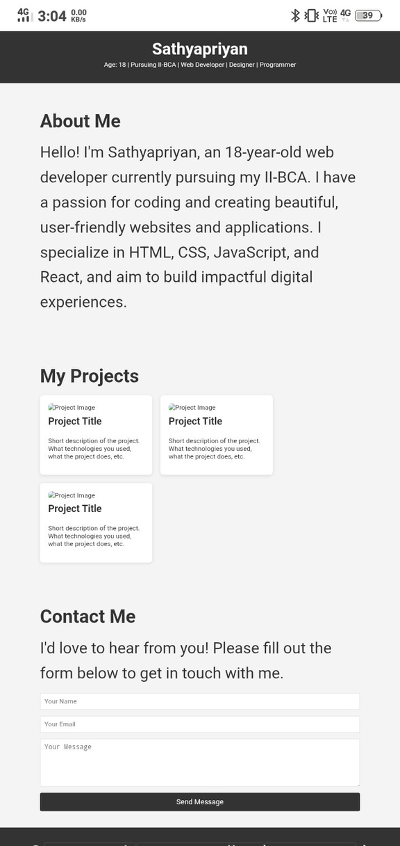

RESULTS AND SCREENSHOTS
3/21/2024 Annual Review
10

Slide 11
GETHUB LINK
https://priyan-420.github.io/Sathya-priyan-portfolio/
https://priyan-420.github.io/Sathya-priyan-portfolio/

Slide 12
CONCLUSION
This portfolio webpage is a simple, stylish, and functional personal site designed with a dark theme and thunder-lightning effect to give a unique visual appeal.
It has a sticky navigation bar with links for certification and contact, a hero section that introduces you, and a footer with an auto-updating year.
combination of clean layout, responsive design, interactive hover effects, and background animation makes it both professional and visually engaging while staying minimal and easy to navigate.
11

